Slide 1


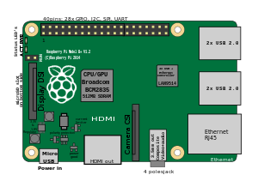
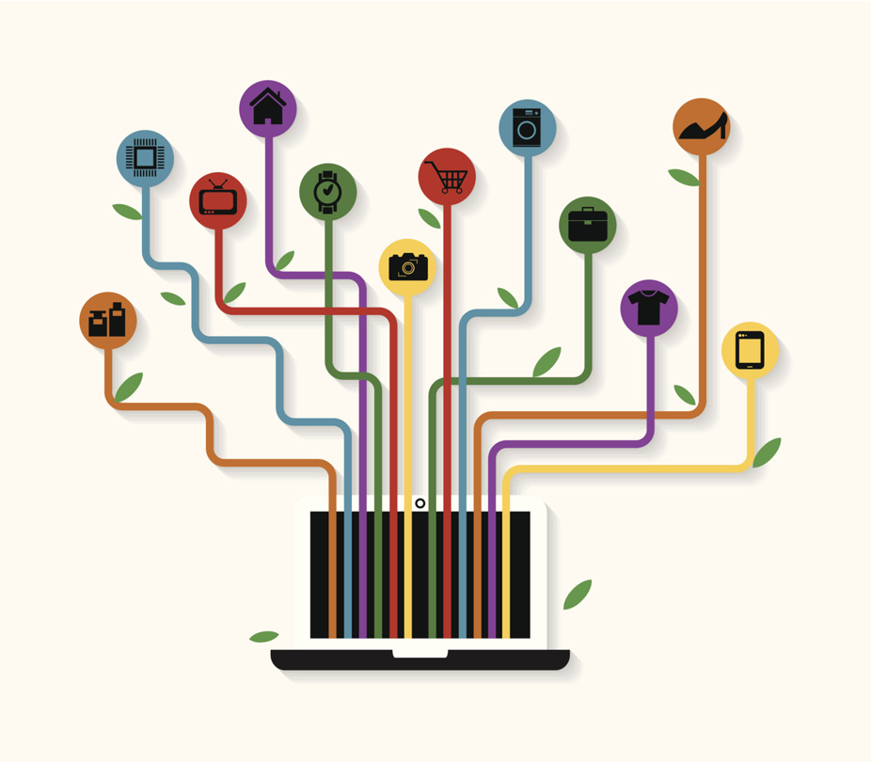
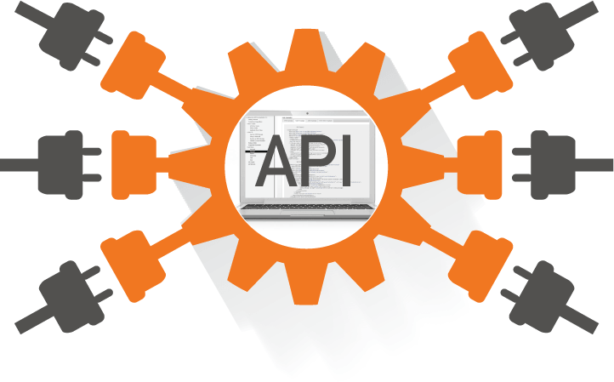
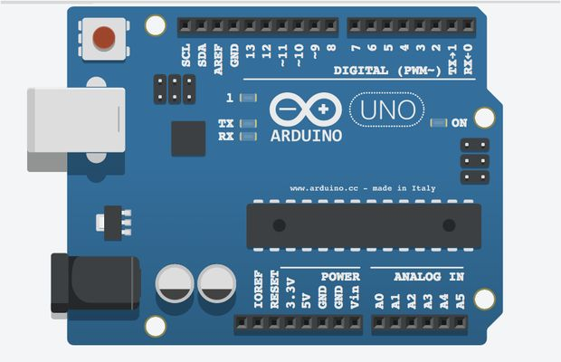

Interoperability and Semantic

Slide 2
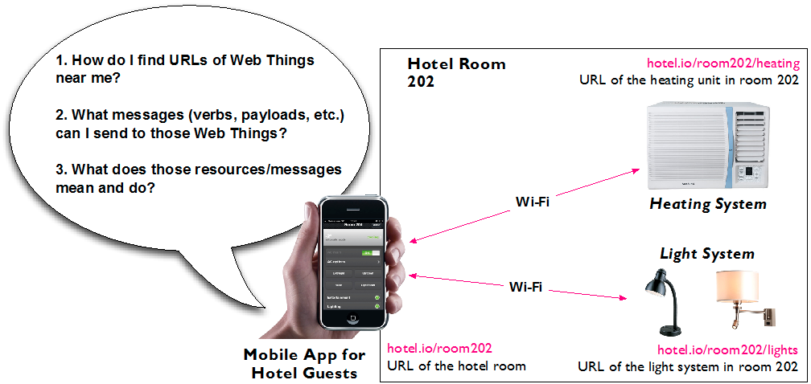
Findability
How do we know where to send the requests (bootstrap problem)?
root URL/resources of a Web Thing
How do we know what requests to send and how?
verbs, format of payloads
How do we know the meaning of the requests/responses?
semantics

Slide 3
Bootstrap Problem
How the initial link between two entities can be established?
Network Discovery
once a device has an IP address (DHCP), it can then broadcast it
mDNS (multicast Domain Name System), DLNA (Digital Living Network Alliance), UPnP (Universal Plug and Play)
Smart TVs (e.g. Apple TV) use DLNA to discover NASs (Network Attached Storage)
not directly usable from browsers, does not propagate beyond local networks
Web Discovery
WWW shifted from a catalogue of few thousand pages (early 90's) to exponentially growing collection of application, documents, multimedia content, etc.
crawling APIs as web pages
simply adding links to resources in their HTML representations
from root, crawler finds resources and creates a tree
use HTTP OPTION to expose supported verbs
use content-negotiation to understand formats available
HATEAOS
responses contain the links to other resources

Slide 4
Web Thing Model
A conceptual model of a Web Thing that can describe the resources using a set of well-known concepts
an official W3C submission (2015): https://www.w3.org/Submission/wot-model/
Entities
Model
a set of metadata that defines various entity aspects
name, description, or configurations
Properties
variables describing the internal state of the entity
clients can subscribe to properties to receive notifications on specific conditions
a threshold for a temperature sensor
Actions
functions offered by the entity
clients can invoke an action to modify the thing
“open”, “close” for a garage door
Things
list of other things
used when a Web Thing is a gateway to other devices

Slide 5
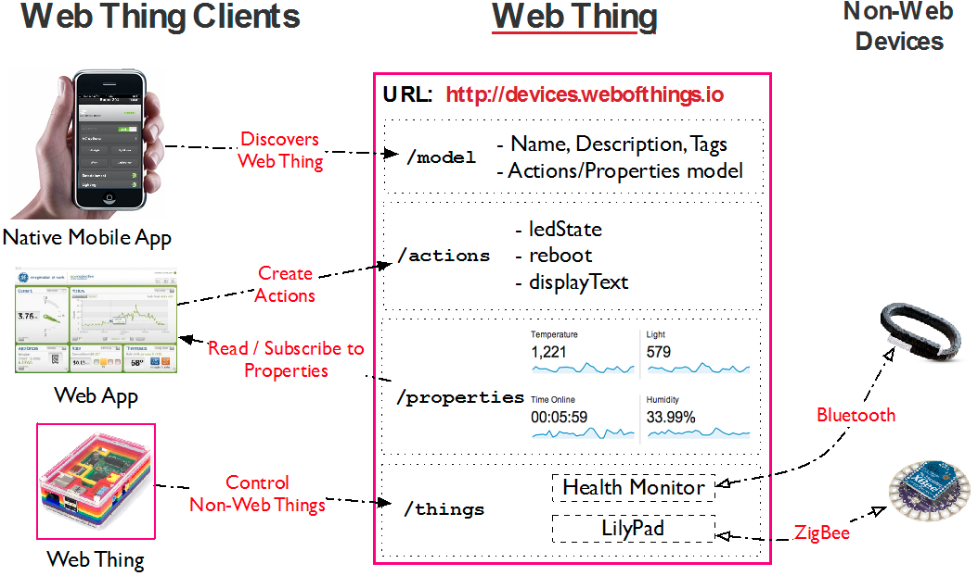
Web Thing Model

Slide 6
Semantics
How to expose a thing so that it means something to other applications, services, and devices
Most of the data on Web pages are unstructured
difficult to understand what a page is about
a restaurant, a person, a movie, or a product?
HTML pages have only a limited ability to tell to clients what they talk about
just define a summary and a set of keywords
Semantic Web and Linked Data
extension of the Web that promotes common data formats
facilitate meaningful data exchange between machines
defined by the World Wide Web Consortium (W3C)
a simple and interesting intro: https://www.youtube.com/watch?v=vioCbTo3C-4
Resource Description Framework (RDF)
complex and heavy standard
controlled vocabularies (ontologies)
RDFa: a lighter version

Slide 7
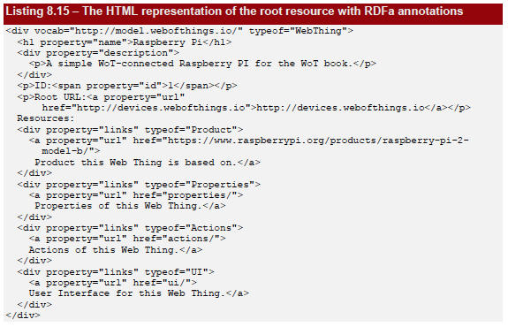
RDFa
Annotate content reusing (or creating) a vocabulary
a set of terms that can be used to annotate a HTML elements
to expose information about thing (name, description, image) we can use the “Product” vocabulary supported by Google
Vocab: define the vocabulary used
Property: defines the various fields of the model
Typeof: defines the type of those elements in relation to the vocabulary

Slide 8
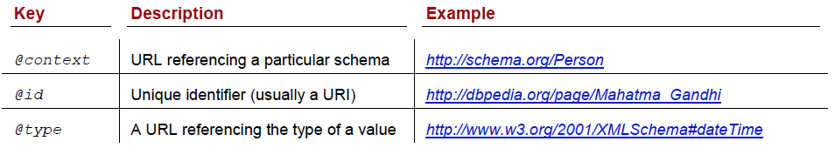
JSON-LD
JSON-based serialization for Linked Data (https://json-ld.org/)
augment JSON documents by adding context information and hyperlinks for describing the semantics of the different elements of a JSON objects
W3C recommendation: https://www.w3.org/TR/json-ld11
MIME type: application/ld+json
Schemas: http://schema.org
Example:
use “Product” schema to add some semantic data to our thing
clients that understand the schema will be able to automatically process information in a meaningful way
use “Place” schema to add location information
more semantic data we add the more findable it will become!
Https://search.google.com/structured-data/testing-tool
e.g. search engines: Google process JSON-LD payloads using the Product

Slide 9
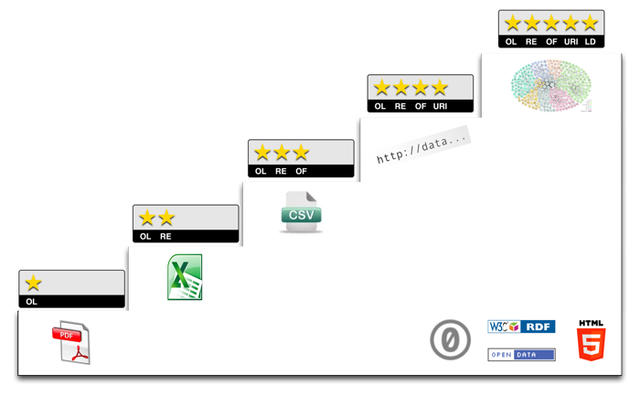
Open Data
Non proprietary format
Machine readable
Easy to access
Easy to use
Reusable without restrictive license
No cost
5-star open data
No star - data is not available under an open licence, even if it is available on-line
One star - data is accessible online, it is readable by the human eye, but not by a software agent, because it is in a closed document format (e.g. a PDF file)
Two stars - data is accessible online in a structured, machine-readable format, but still depending on proprietary software (e.g. Word or Excel).
Three stars - users will no longer need to rely on proprietary software (e.g. CSV instead of Excel)
Four stars - data is available online through the use of a unique URI
Five stars - data is also linked to other data, fully exploiting its network effects (e.g. tlinks to Wikipedia).

Slide 10
Hands-on Activities
Adding JSON-LD information to our WoT Proxy adopting the “Product” schema

